Slide 1
“Let’s Code” – A DELL Event

Slide 2
Improve Efficiency of Reconciliation
Team Members:
Shivank Pathak(B416045)
Abhishek Patel(B516002)
Vijendra Sharma(B516052)
Yasharth Tandon(B516063)

Slide 3
Problem Statement
Messages communicated between 2 or more IT applications are getting corrupted or lost, causing variance in the data maintained by these applications.Due to lost messages or errors, the data between these applications is not consistent, resulting in manual reconciliation efforts. Currently, Message Queue(RabbitMQ) is used to communicate data.

Slide 4
Why Not Message Queues?
Data is lost or there is variance in data.
If there are many messages the order of message may get distorted.
if the one server goes down the message might lost

Slide 5
Solution
Blockchain can be used to tackle with this problem.
The data in Blockchain is consistent due to consensus.So, it will maintain its Integrity and Authenticity.
Consensus is a process of agreeing on one result among a group of participants to guarantee data consistency.

Slide 6
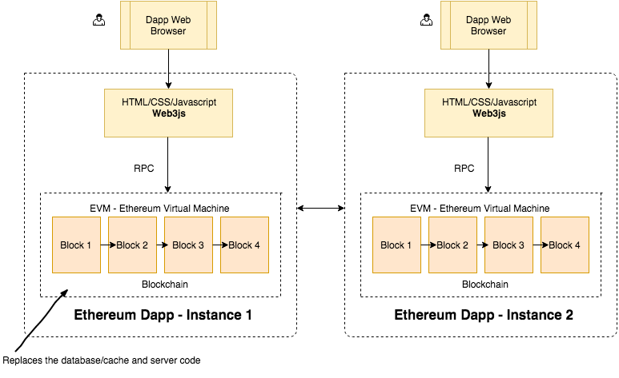
MODEL PIPELINE

Slide 7
Effectiveness of Solution
Following properties account for the effectiveness of our solution:
Atomicity: All of the operations in the transaction will complete, or none will.
Integrity: The data will not change while transferring messages.
Authenticity: The transaction will reach to its intended user only.
Durability: Upon completion of the transaction, the operation will not be reversed.

Slide 8
Tech Stack
Back End
Solidity
Ethereum
Node.js
Web3.js
Ganache
Truffle
Front End
Javascript
HTML
CSS

Slide 9
Cost of Implementation
Deploying a contract has a minimum fee of 32000 gas, plus 200 gas per byte of the source code.
With the current block gas limit around 8k, you would spend 10 Gwei gas price around 0.08 Eth, which is $24.
1'080'000 transactions would cost ~90 ETH/~$32'400 with an average cost of transaction ~0.001 ETH/$0.03.

Slide 10
Thank You

